Slide 1

Mastering the Lightning Framework
Part 1 – The declarative aspects
JF Paradis
Principal Engineer - Salesforce
@jfparadis

Slide 2
Overview
In this session you will learn:
What is Lightning, and how it compares with other Single Page Application frameworks.
What is a component-based architecture, and its relation with OOP.
How the four Lightning base languages (XML, CSS, JavaScript, and Apex) are used and combined to build components, and applications.

Slide 3



Single Page Application Frameworks
Polymer
React
Lightning
Angular
Ember

Slide 4
What we do like the others
Lightning follows current best practices:
Rendering like React
Bindings like Ember
Styling like Sass and Bootstrap
We are looking ahead:
Emerging practices, like Web Components
Member of TC39, the committee driving the evolution of JavaScript

Slide 5
What we do differently
Lightning focuses on business needs:
Access rights
Secure DOM and Execution Context
Stable API
Complete platform
We build an ecosystem:
App Exchange
Interoperability with VisualForce
Leverage current assets

Slide 6
Single Page Application Frameworks
Lightning
Polymer
React
Aura
Angular
Ember

Slide 7
Open-Source Framework: Aura
Available at https://github.com/forcedotcom/aura
Think of Aura in Lightning as Webkit in Safari and Chrome
Transparency
Learning tool
Open to contributions
Contains features and components not yet exposed in Lightning

Slide 8
Four languages in one framework
LIGHTNING
XML
CSS
JS
Apex

Slide 9
Four sections
XML
Section 1: XML Component Definition
JS
Section 3: JS Controller and Helper
Section 2: Styling Components
Section 4: Apex Controller
CSS
Apex

Slide 10
Section 1: XML Component Definition
1.1 Component Based architecture
1.2 Structure of a component
1.3 Key components
1.4 Implementation Detail

Slide 11
1.1 Component-based architecture

Slide 12
Component-based Frameworks
Lightning Components
“Components are self-contained and [...] represent a reusable section of the UI, and can range in granularity from a single line of text to an entire app.”
W3C Web Components
“Web Components [...] define widgets with a level of visual richness and interactivity not possible with CSS alone, and ease of composition and reuse”
Flash Components
“Components are pre-built controls [...] that you can reuse within your projects. [...] A component is generally a user interface widget, like a button, a checkbox, or a menu bar.”

Slide 13
Similarities: Component-based vs Object Oriented
Polymorphism: process objects using a parent type or a parent class.
Inheritance: extend a behavior of a superclass.
Interfaces: define a contract.
Composition: contain instances of other classes.
Encapsulation: hide the data and the implementation.
Separation of concerns: deal with related sets of information.
Generalization: extract shared characteristics into superclass.
Specialization: derive subclass with specific behavior.
Modularity: write according to functionality and responsibility.

Slide 14
Differences: Component-based vs Object Oriented
Object-oriented
Write according to a mental model of the actual or imagined objects it represents, for example a user, a record, etc.
Component-based
Glue together other prefabricated components - much like in the fields of electronics or mechanics.

Slide 15
Inheritance vs Composition
Inheritance defines “is a”
Composition defines “has a”
Ferrari
Car
Frame
Turbo Engine
Formula 1
Racing Tires
Ferrari
Cockpit

Slide 16
1.2 Structure of a component

Slide 17

Example set 1: Lightning vs HTML /c/basics101.app Lightning vs Web Components /c/basics102.app

Slide 18
Component bundles
A bundle is a folder containing the resources owned by the component: XML, JS, CSS, etc.
The name of the folder is the component name.
There is always one XML file per bundle, with the same name as the bundle.
The file extension defines the type of bundle:
.cmp = component
.app = application
.intf = interface
.evt = event

Slide 19
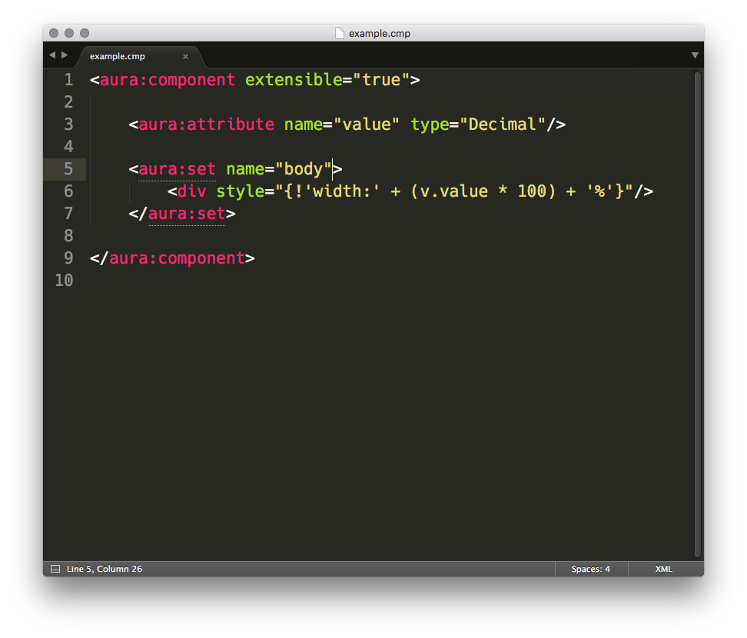
Example of a component XML

Slide 20
Inside the component XML
Define the base type (enclosing tag):
<aura:component>, <aura:application>, <aura:interface>, <aura:event>
Set attributes values:
implements = "<name>" (no default)
abstract = "<true|false>" (defaults to false, can’t create an instance if true)
extensible = "<true|false>" (defaults to false)
Declare definitions
<aura:attribute name="<name>”/> (declare an attribute)
Important:
<aura:set> (not a declaration, alternative syntax to set an attribute)
Used primarily to set facets (arrays of components)
<aura:set attribute="body”> (not required, implied)

Slide 21
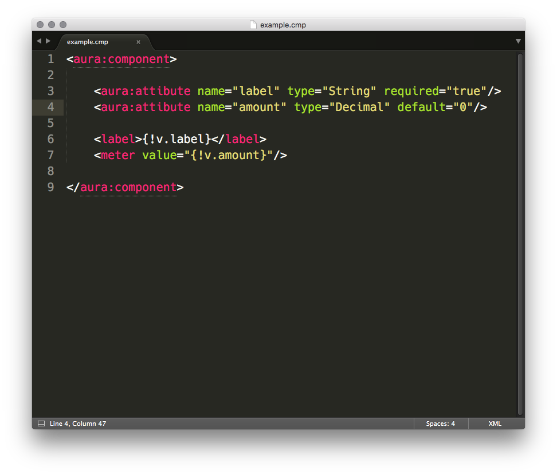
Example of attribute declaration

Slide 22
Example set 2: Passing attributes /c/buttonTest.app?label=Ok /c/meterTest.app?value=0.5

Slide 23
Component Attributes
Attributes are used to pass values into a component.
The declaration:
must have a name and a type,
can set a default value, can specify required.
The attributes are reusable declaratively inside the component.
The reference follows the v.<name> syntax.
Attributes member can also be referenced:
Object members: v.<name>.<member>
Array members: v.<name>.<index> or v.<name>[<index>]
All attributes are shared with subclasses except body.

Slide 24
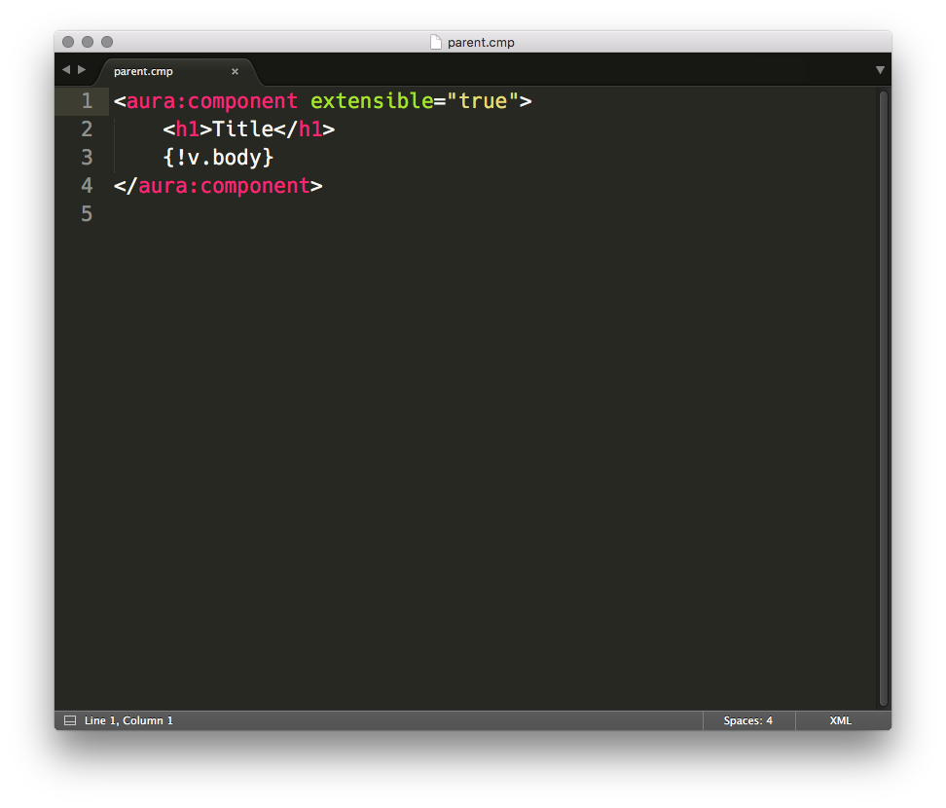
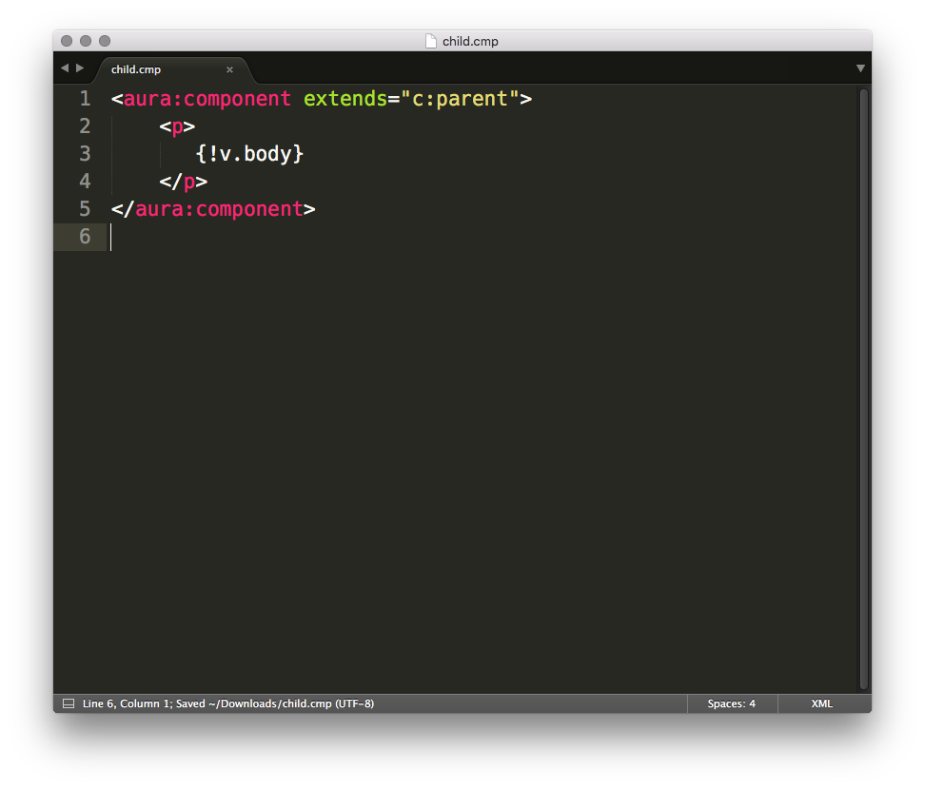
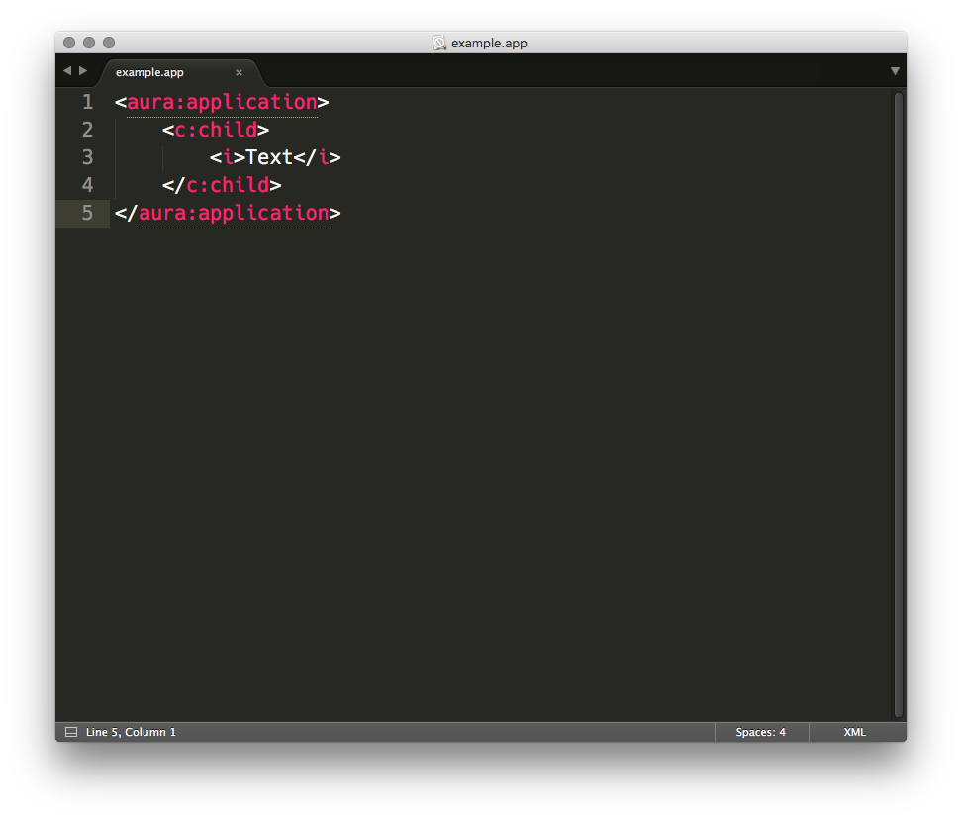
Children populate the body attribute of their parent

Slide 25
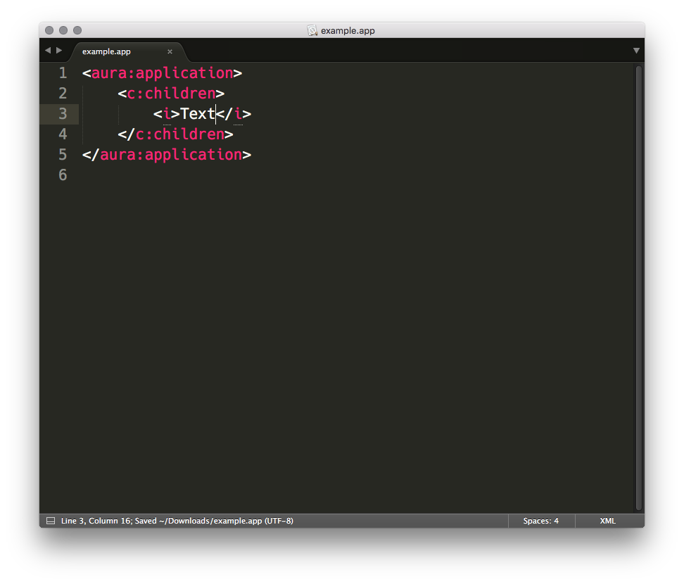
Children populate the body attribute of their parent
<h1>Title</h1>
<p>
<i>Text</i>
</p>
<p>
<i>Text</i>
</p>
<i>Text</i>

Slide 26
Example set 3: Simple Parent & Simple Child /c/basics103.app Ignored Child /c/basics104.app

Slide 27
The body attribute
It is declared by default on all components.
Set to everything between opening and closing tag
It’s of a special type Aura.component[] called “facet”.
Equivalent to node properties innerHTML and children.
There is one body instance for each level of inheritance.
The body has a peculiar mode of inheritance:
The child sets the body attribute of its parent,
The parent can output its v.body inside its own body, it can also ignore it.
Consequences:
No child can override the parent body.
Top parent ultimately decides what a component will render.

Slide 28
Expressions
Two types: property reference or function.
Expression functions look like JavaScript but they work differently.
They use a subset of the JavaScript functions.
Those functions have logic to handle in null and undefined:
null + "abc" = "nullabc" in JavaScript, but "abc" in Lightning.
undefined + null = NaN in JavaScript, but "" in Lightning.

Slide 29
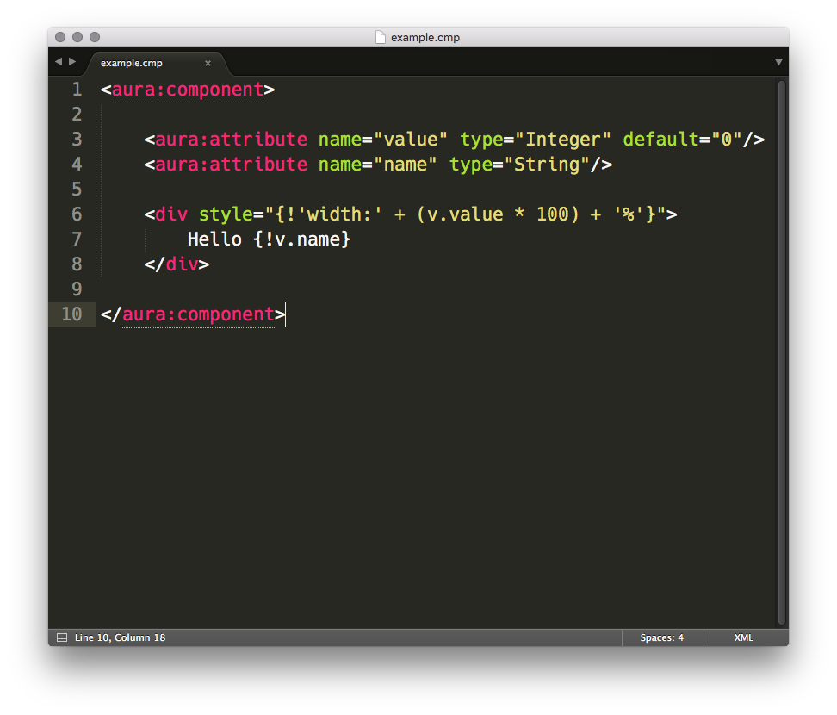
Expressions: examples

Slide 30
Expressions: usage
Attribute value passing (like passing a value to a JavaScript function):
<ui:button label="{#v.whom}"/>
Attribute reference passing (special Lightning mode):
<ui:button label="{!v.whom}"/>
Calculation:
<div style="{!'width:' + (v.value * 100) + '%'}"/>
Conditional Expression:
<div class="{!v.isHidden ? 'hidden' : 'default'}"/>

Slide 31
Expressions: functions
Math:
add()
sub()
mult()
div()
mod()
abs()
neg()
Logical:
eq()
ne()
lt()
gt()
le()
ge()
and()
or()
not()
Special:
join(separator, string…)
format(label, parameter…)
empty(parameter)
if(condition, consequent, alternative)

Slide 32
1.3 Key Components

Slide 33
HTML components
HTML components are instances of <aura:html>.
Can be created using <aura:html tag="<tag>”> if an expression is required.
The majority of HTML5 tags are alowed.
We don’t support unsafe or unnecessary tags:
No <applet>, <object>, <font>, etc.
HTML components are not extensible, neither is <aura:html>.

Slide 34
Example set 4: Using <aura:if> /c/basics106.app Using <aura:renderIf> /c/basics107.app

Slide 35
Conditionals
There are two: <aura:if> and <aura:renderIf>:
conditional: attribute “isTrue”,
consequent: attribute “body”,
alternative (optional): attribute “else”.
Why two?
<aura:renderIf> is the naive implementation,
equivalent to using a function expression {! v.isTrue ? v.body : v.else },
needs both facets created before the function is evaluated,
don’t use <aura:renderIf>, it creates more components.
Difference: <aura:if> creates and renders only the consequent or the alternative, <aura:renderIf> creates both consequences, renders one.

Slide 36
Example set 5: Using <aura:iteration> /c/basics108.app

Slide 37
Loops
One component <aura:iteration>.
Uses the body as a template to create multiple instances.
Iterates over an array attribute named items.
Each item is placed into a customizable attribute called var.
The loop index is specified using indexVar.
Attributes start and end can be used to control which items are rendered.

Slide 38
1.4 Implementation Details

Slide 39
What’s under the hood?
From XML to DOM
Lightning is not a template engine.
Counting component instances
Lightning is optimized for composition
Inheritance is as expensive as composition
Components created ≠ rendered:
Best illustrated with <aura:if> and <aura:renderIf>

Slide 40
From XML to DOM
Lightning isn’t a JS template engine (mustache, handlebars, etc.) which parses the template file to replaces variables:
Template → HTML → DOM
Lightning create components:
The server creates Java Objects from component XML,
Components are serialized to JSON,
The client creates JS Component instances,
The JS Components create DOM elements:
XML → Java → JSON → JS → DOM

Slide 41
One instance per child and per parent
<aura:component>
<div><div><div><div>
</...</...</...</...
</aura:component>
<aura:application>
<meter>60%</...
<c:meter>60%</...
<c:meter>60%</...
</aura:application>
= 2 components (current + base parent)
= 4 components (simple HTML)
Total: 6
= 2 components
= 2 components (simple HTML + text)
= 7 components (6 above + text)
= 7 components
Total: 18

Slide 42
How to count components instances
In the browser console:
$A.componentService.countComponents()
With a bookmarklet:
javascript:alert("Components: "+$A.componentService.countComponents())

Slide 43
Example set 6: Counting components /c/basics105.app

Slide 44
Section 2: Styling Components
2.1 CSS in components
2.2 Limits of encapsulation
3.3 Using OOCSS

Slide 45
2.1 CSS in Components

Slide 46
Example set 7: CSS in components /c/basics201.app

Slide 47
CSS in components
What you do:
create a file named <component>.css
placed in the component bundle
all rules start with .THIS
What Lightning does:
wire the file to the cmp
convert .THIS to .<namespace><Component> pseudo CSS class
add <namespace><Component> to top element(s)
creates any vendor-specific extension.
CSS rules are scoped to a component since namespace:component is unique.

Slide 48
2.2 Limits of Encapsulation

Slide 49
Example set 8: Limits of CSS encapsulation /c/basics202.app

Slide 50
Limits of CSS encapsulation
styling crosses component boundaries
no true encapsulation, unlike virtual DOM from Web Components
no CSS file means .THIS not added*
parent can’t style using generated class name
multiple top elements means multiple .THIS added
CSS rules might not apply to every element
removing top element might change rules
.THIS tag becomes tag.THIS
better to style other components by assigning them classes (API)
no attribute class by default on custom components
implement it yourself

Slide 51
2.3 Using OOCSS

Slide 52
Before OOCSS?
Limit of component CSS:
it creates a lot of repetition
styles changes mean manually updating every component
Limitation of “skinning”:
overriding styles means more CSS
breaks encapsulation
unstable
Limitations of CSS variables:
styles are usually related
a change in one style might produce unpredictable results
e.g. text color and background color, padding

Slide 53
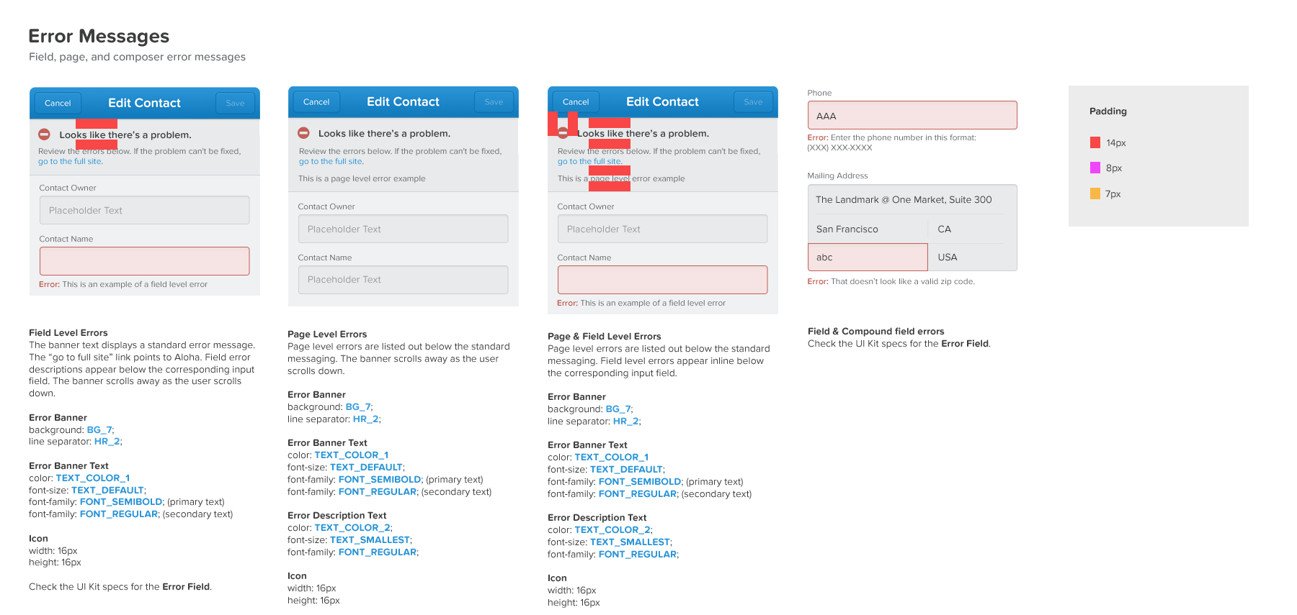
Using a redline

Slide 54
What is OOCSS?
Object Oriented CSS
technique to write CSS
creates related CSS classes each one containing relates styles
e.g. Bootstrap, jQuery UI, Foundation, Semantic UI
Benefits:
creates reusable CSS, reduces CSS bloat and improves consistency
improves predictability
creates an abstraction layer, an API
e.g. components use the OOCSS classes as a styling vocabulary
maintains functionality and presentation as orthogonal concerns

Slide 55
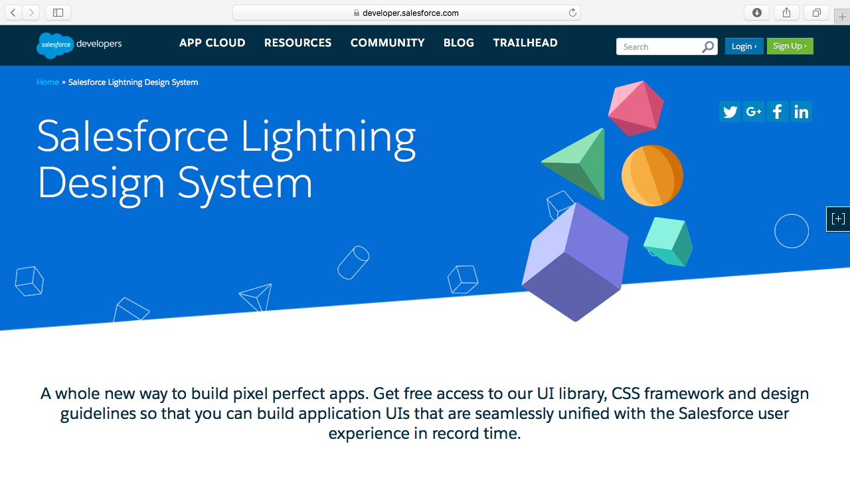
Our OOCSS

Slide 56
Salesforce Lightning Design System
Documentation
https://developer.salesforce.com/lightning/design-system
How to use it:
Install the package
Add a declaration
<ltng:require styles="/resource/SLDS105/assets/styles/salesforce-lightning-design-system.css"/>
Start writing your components
Open-source
https://github.com/salesforce-ux/design-system

Slide 57
BEM Naming
Method of naming components
Block:
Main component name
Element:
Part of a component
Separated by two underscore __
Modifier:
Component or element variation
Separated by two dashes --
Example: slds-modal__header, slds-text-heading--medium

Slide 58
Examples set 9: Using SLDS /c/basics203.app

Slide 59

thank y u

Slide 61
Title Slide
With subtitle
Marc Benioff
CEO
@jfparadis

Slide 62
Secondary Title Slide
With subtitle
Marc Benioff
CEO
@marcbenioff

Slide 63
Title and Subtitle Slide
With logo

Slide 64
Title and Subtitle Slide
Without logo

Slide 65
Title and Subtitle Slide
With logo
And content

Slide 66
Title and Subtitle Slide
Without logo
And content

Slide 67
Customer Title Slide
Title of Customer

Slide 68
Basic Segue Slide

Slide 69
Basic Segue Slide

Slide 70












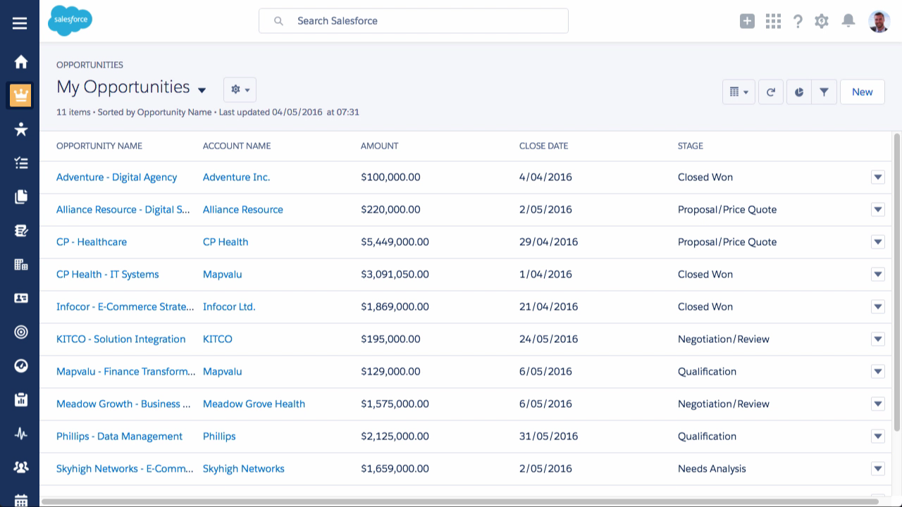

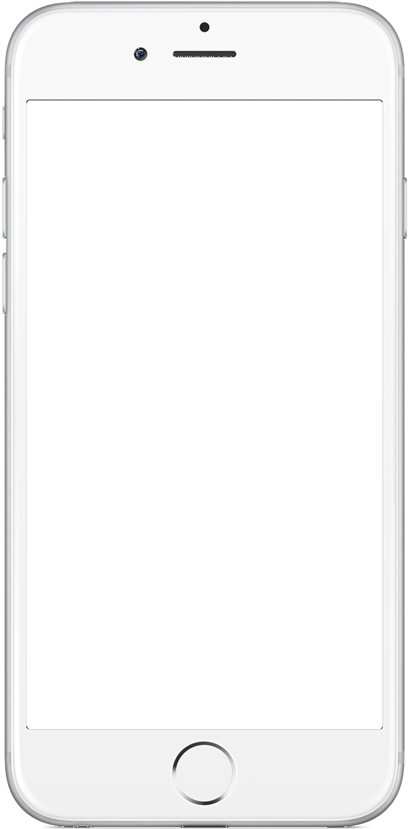
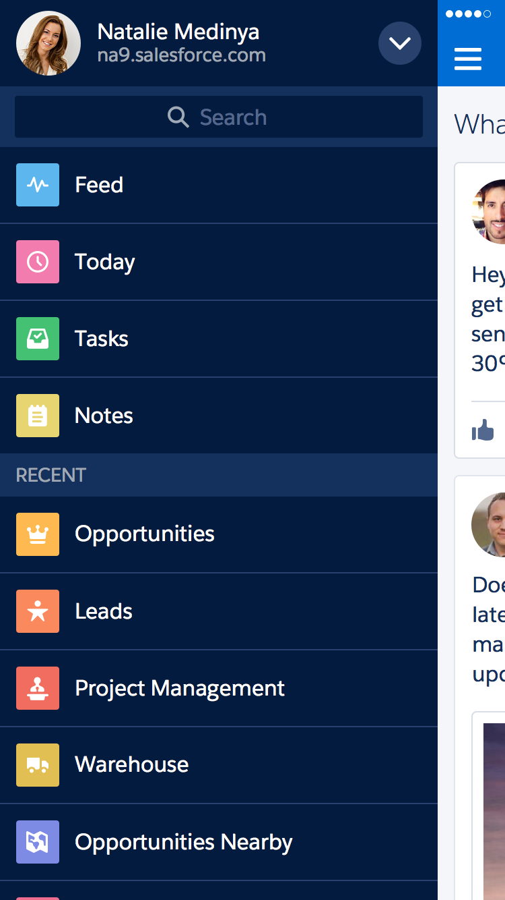
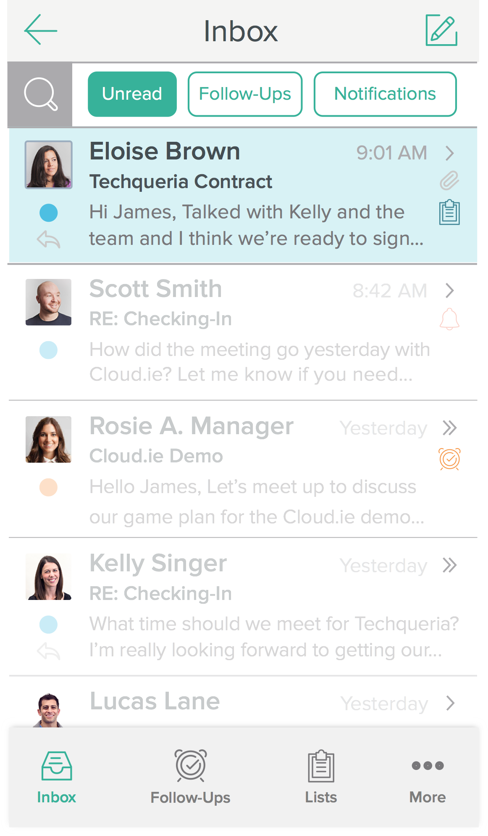
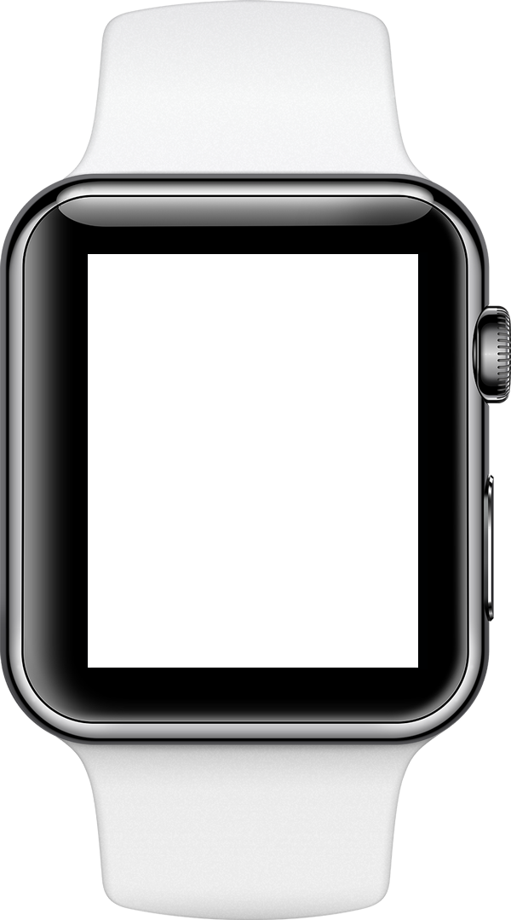
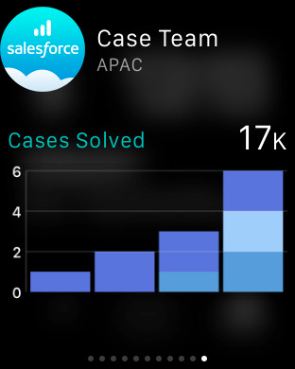

Sales Cloud Lightning
#1 Sales application
Sell the way you want
Lightning Platform & Ecosystem
Sell faster
Salesforce SteelBrick & Microsoft Integrations
Sell smarter
SalesforceIQ & Sales Wave Analytics
Sell from anywhere
Salesforce1 Mobile App
⁺37%
revenue increase
Amy Palan
Partner

Slide 71

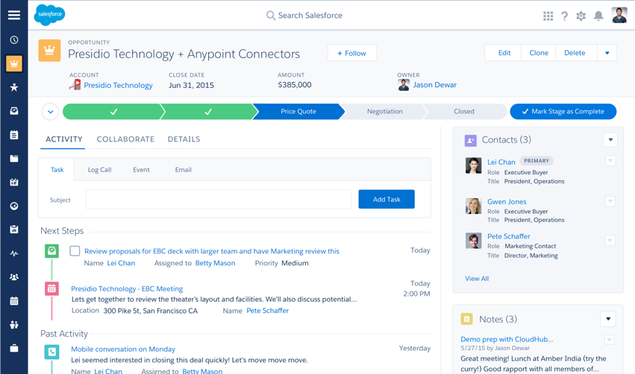
Sales Cloud Lightning
#1 Sales application
Sell the way you want
Lightning Platform & Ecosystem
Sell faster
Salesforce SteelBrick & Microsoft Integrations
Sell smarter
SalesforceIQ & Sales Wave Analytics
Sell from anywhere
Salesforce1 Mobile App
⁺37%
revenue increase

Slide 72
thank y u

